Slide 1
Cyber Crime in India(2016-2018)

Slide 2
Summary
61K cyber crimes reported across the years 2016, 2017, 2018
Uttar Pradesh, Maharashtra and Karnataka top the list in all the 3 years
Union Territories contribute very little(less than 1%) to the national total.
Steady increase in all regions of India by the time we reach the year 2018

Slide 3
Key Insights
Uttar Pradesh, Maharashtra and Karnataka contribute to 15% of the national total but Maharashtra did see a decline in 2018
Northern part of India contributes to the majority and eastern part of India contributes the least of the cases. However, with averages, the western part of India stands out with the majority count.
3 UTs and 1 State in the Zero crime list – D&N Haveli, Daman & Diu, Lakshadweep and Nagaland in one of these years

Slide 4
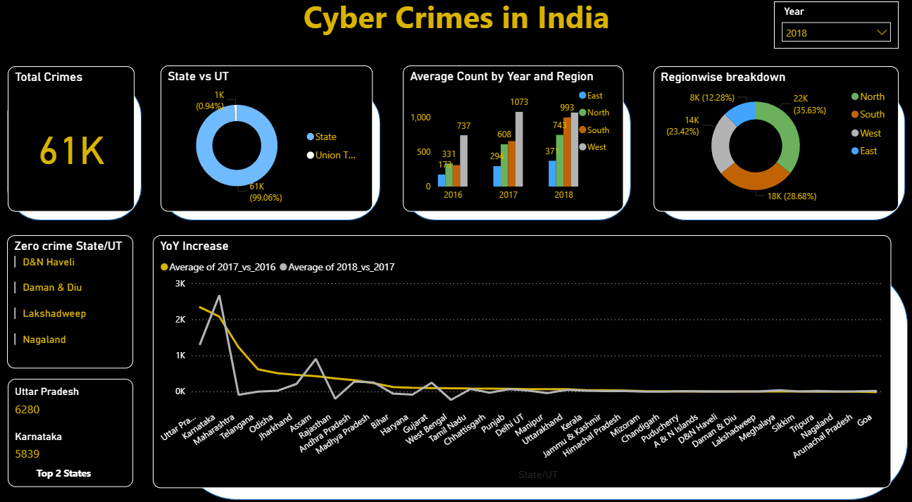
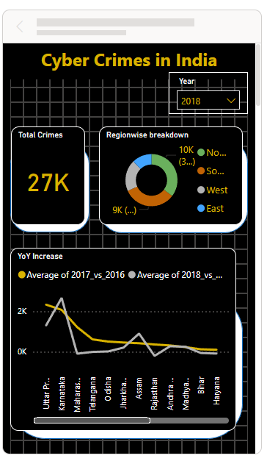
Desktop View
Mobile View

Slide 5
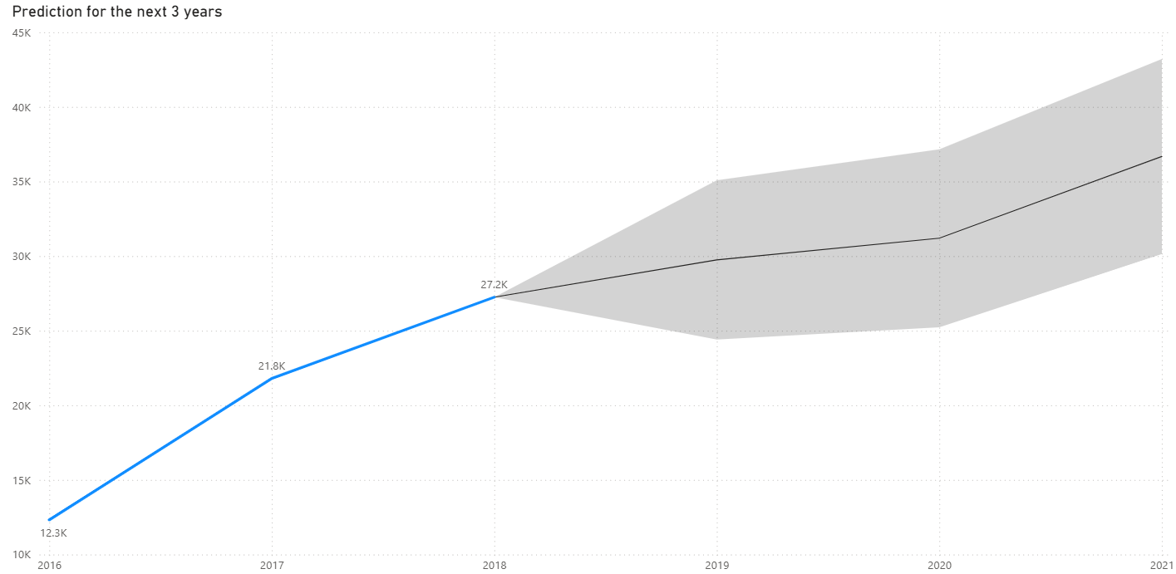
Prediction
When we pull a prediction for the next 3 years, we see the total count jumping to around 37K by 2021

